Slide 1

Library Management System
Lalith Chandra Attaluri
Madhu Varma Rudraraju
Udaya Byreddy

Slide 2

Story of the Project
Motivation for this project is to create a prototype of Library Management portal that can ease the tasks for the staff of Library and to provide efficient services to Graduate and Undergraduate Students of a particular College

Slide 3

What can Application do?
The key idea of this project is to provide different set of permissions for an admin who are library staff and users who are students. Also an individual who neither have admin or user access can atleast browse the books that are currently available for checkout.

Slide 4


Dataset
The dataset which we are using is a manually built dataset that contains information of all the books that are available in UMKC library and the dataset targets the Undergraduate and Graduate students having a diversified backgrounds.

Slide 5

What does Dataset contain?
Title: Name of the book
Author: Name of the book writer
Published_year: Year in which the book is published
Published_date: Date on which the book is published
Subject: Subjects which the book is related to

Slide 6
Admin (Library Staff)
User (Students)
Browse Books
Portal Modules

Slide 7
Admin Privileges
Signup
Login
Logout
Add new books
Update existing books
Delete books
Search books by its title and category
Find users
Delete the user
Update admin profile details and their passwords

Slide 8
User Privileges
Signup
Login
Logout
Checkout a Book
Book Renewal
Book Return
Update Profile Details and their Passwords
Delete Account

Slide 9
Browse Books
This functionality is accessible to anyone who has the URL of our portal. Here we can browse the available books for checkout

Slide 10

Working Screens For Library Management System

Slide 11
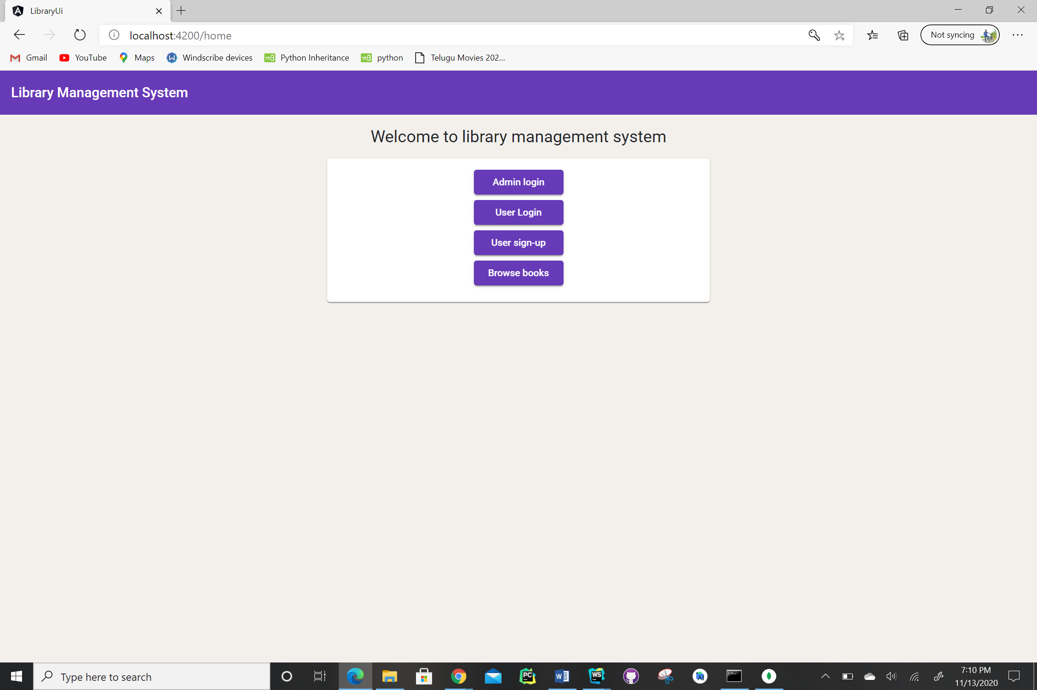
Home Screen of Library Management System

Slide 12
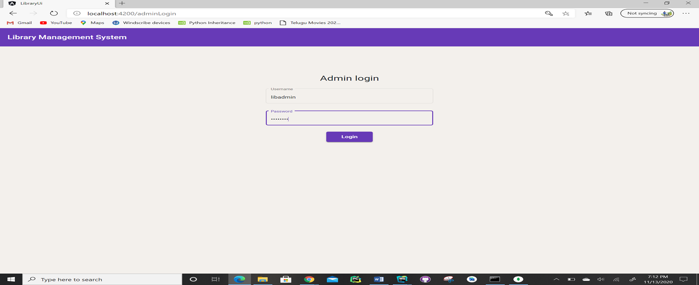
Admin Page Login Screen

Slide 13
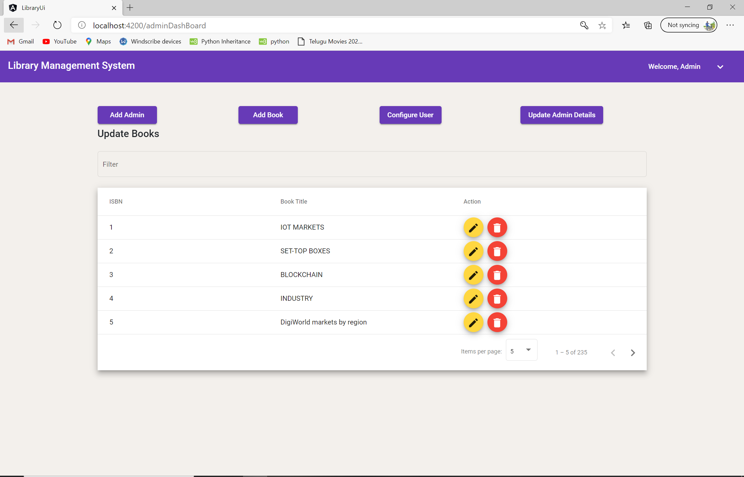
Admin Dashboard

Slide 14
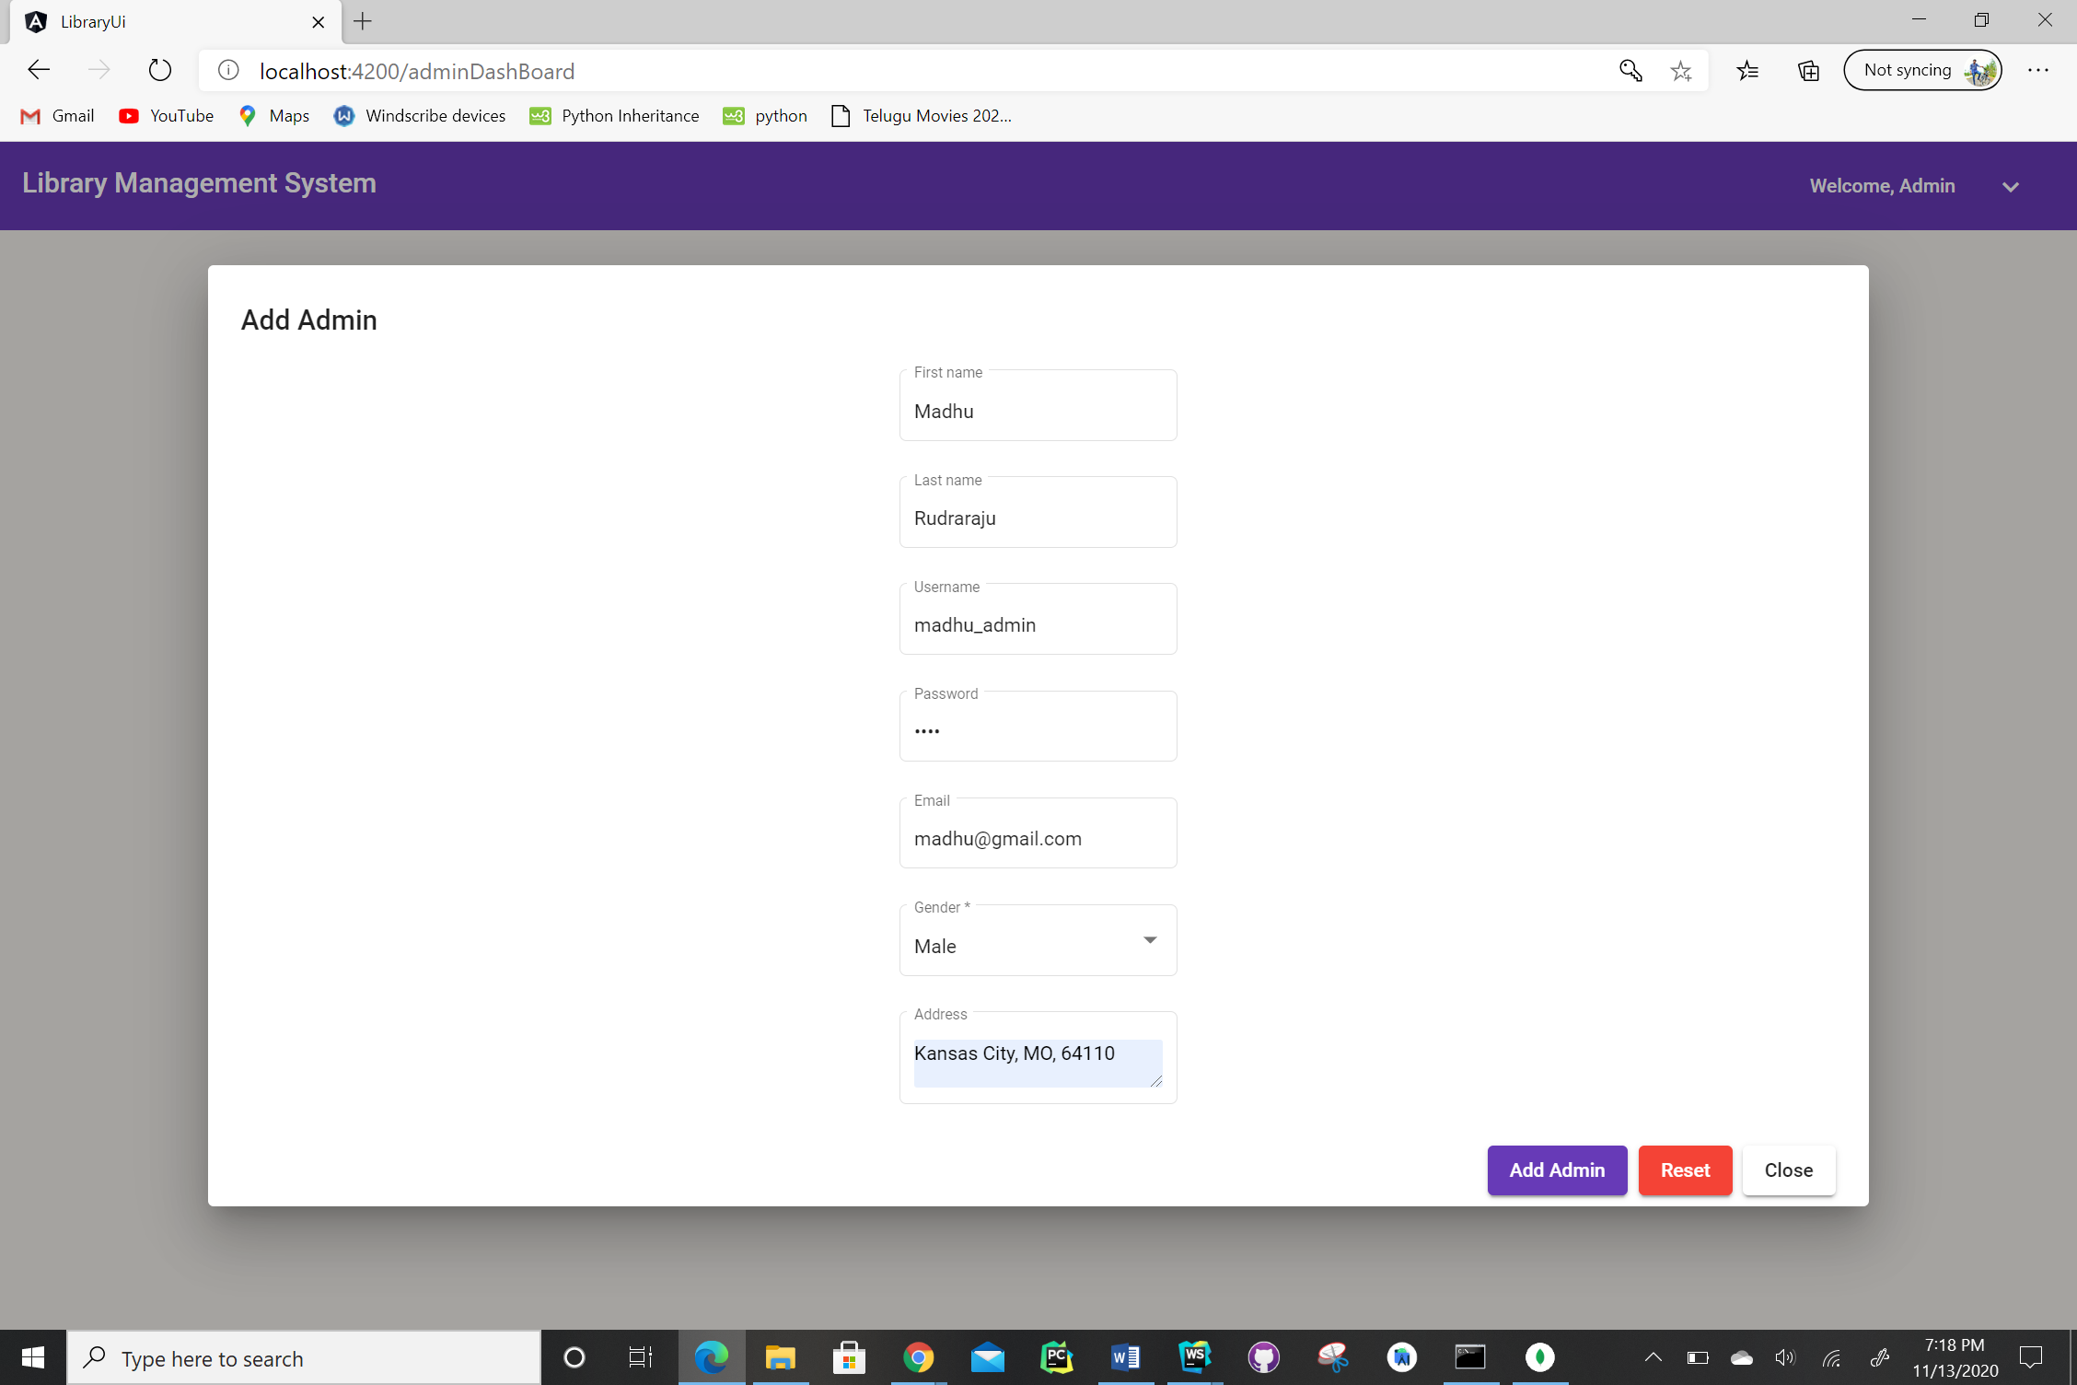
Adding a Admin

Slide 15
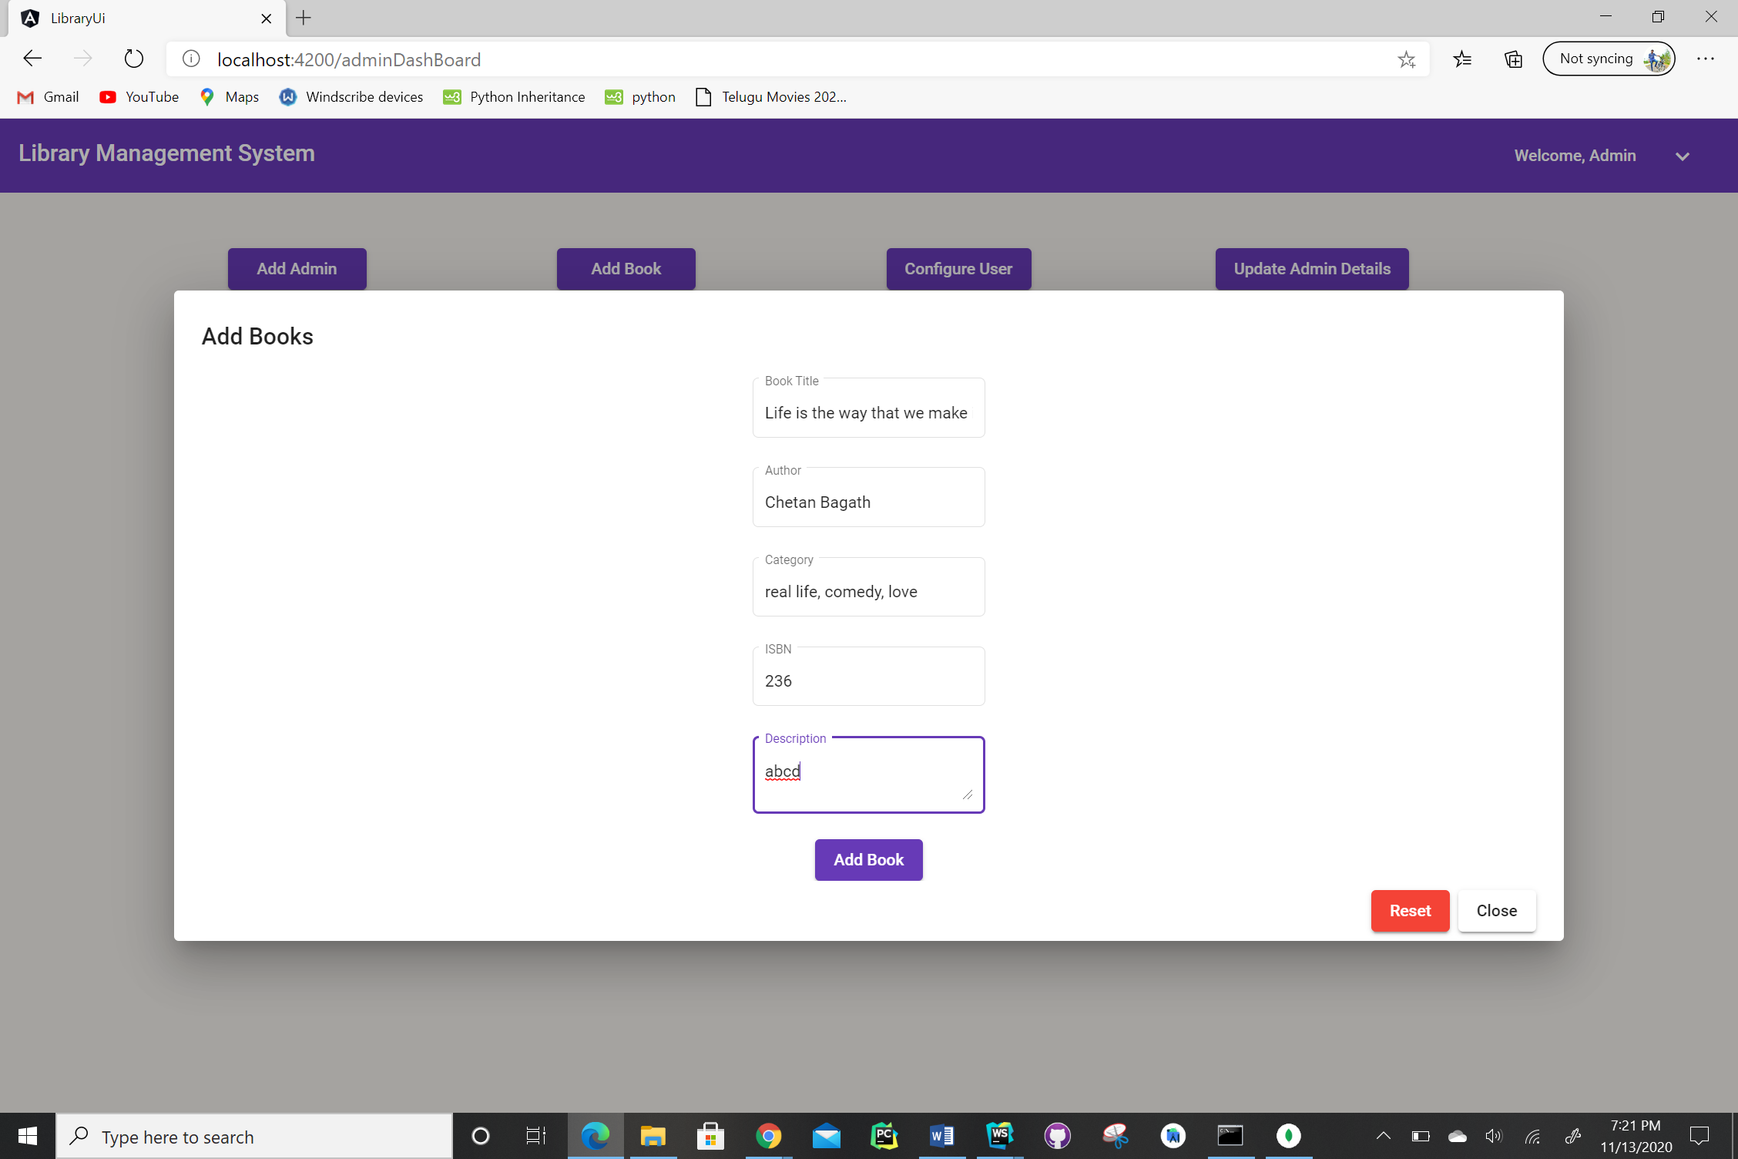
Adding a Book

Slide 16
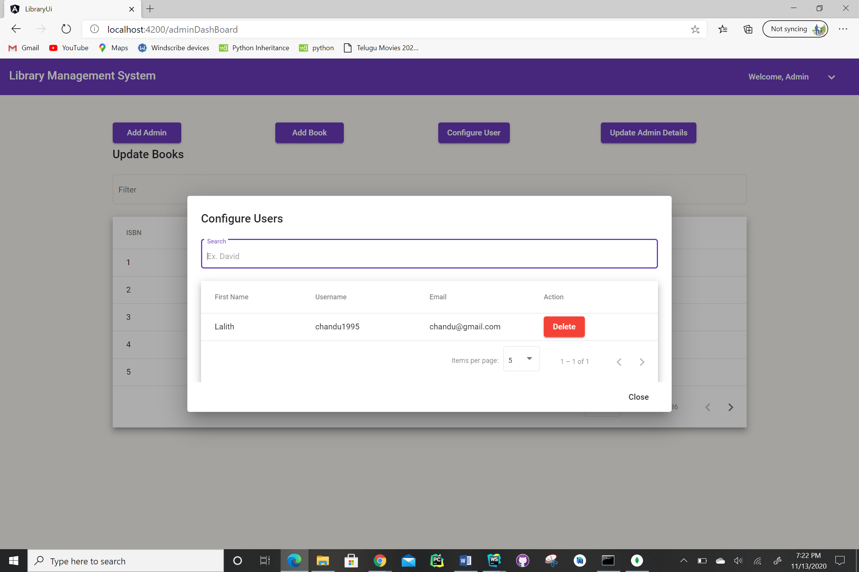
Configuring a User

Slide 17
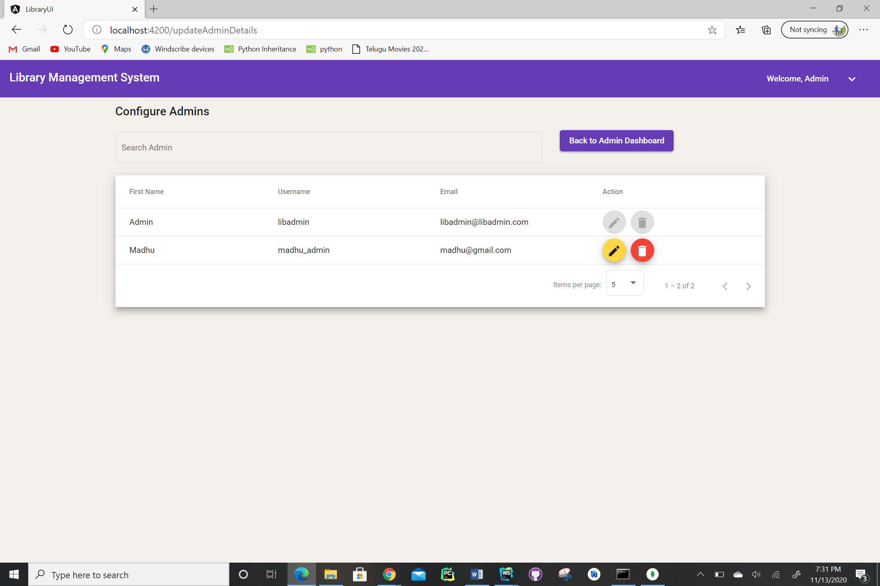
Updating Admin details

Slide 18
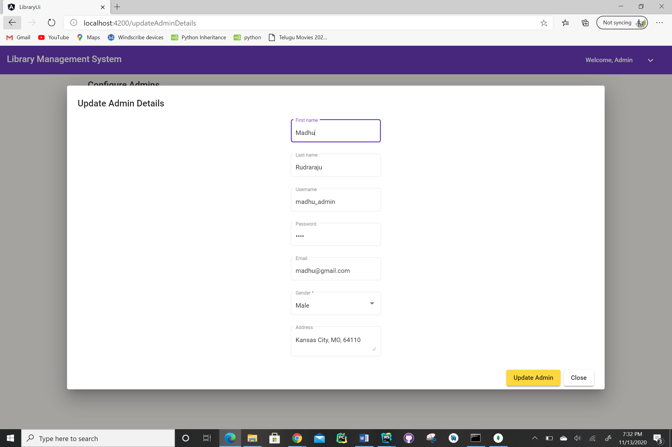
Updating Admin Details

Slide 19
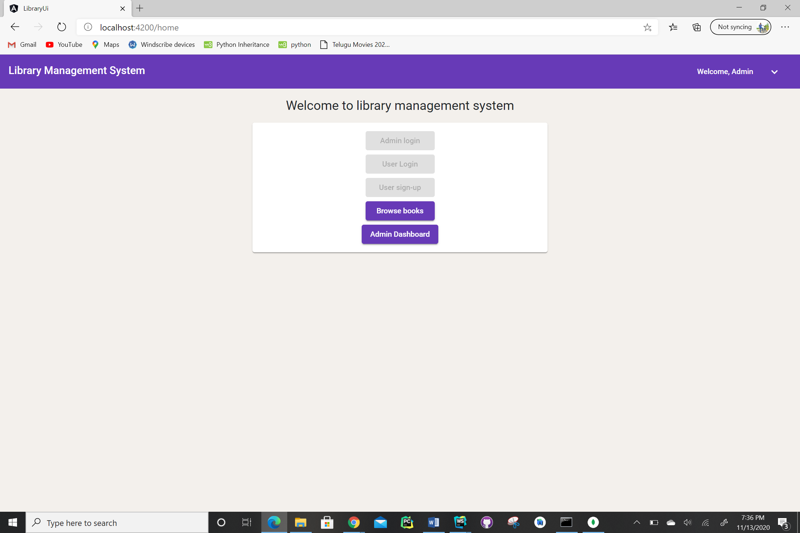
Back to Home Screen

Slide 20
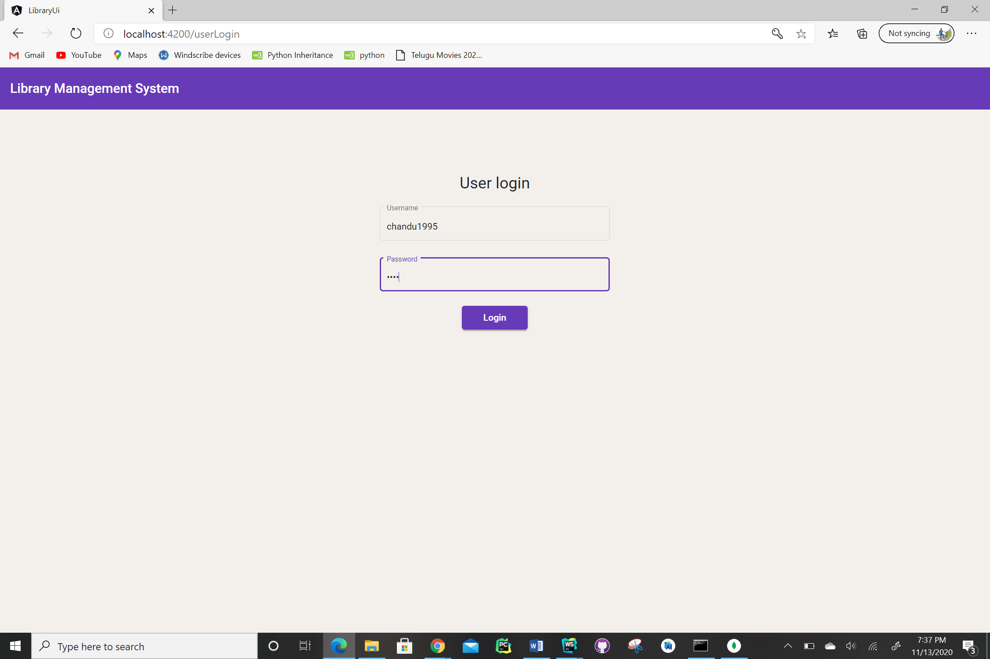
User Login Screen

Slide 21
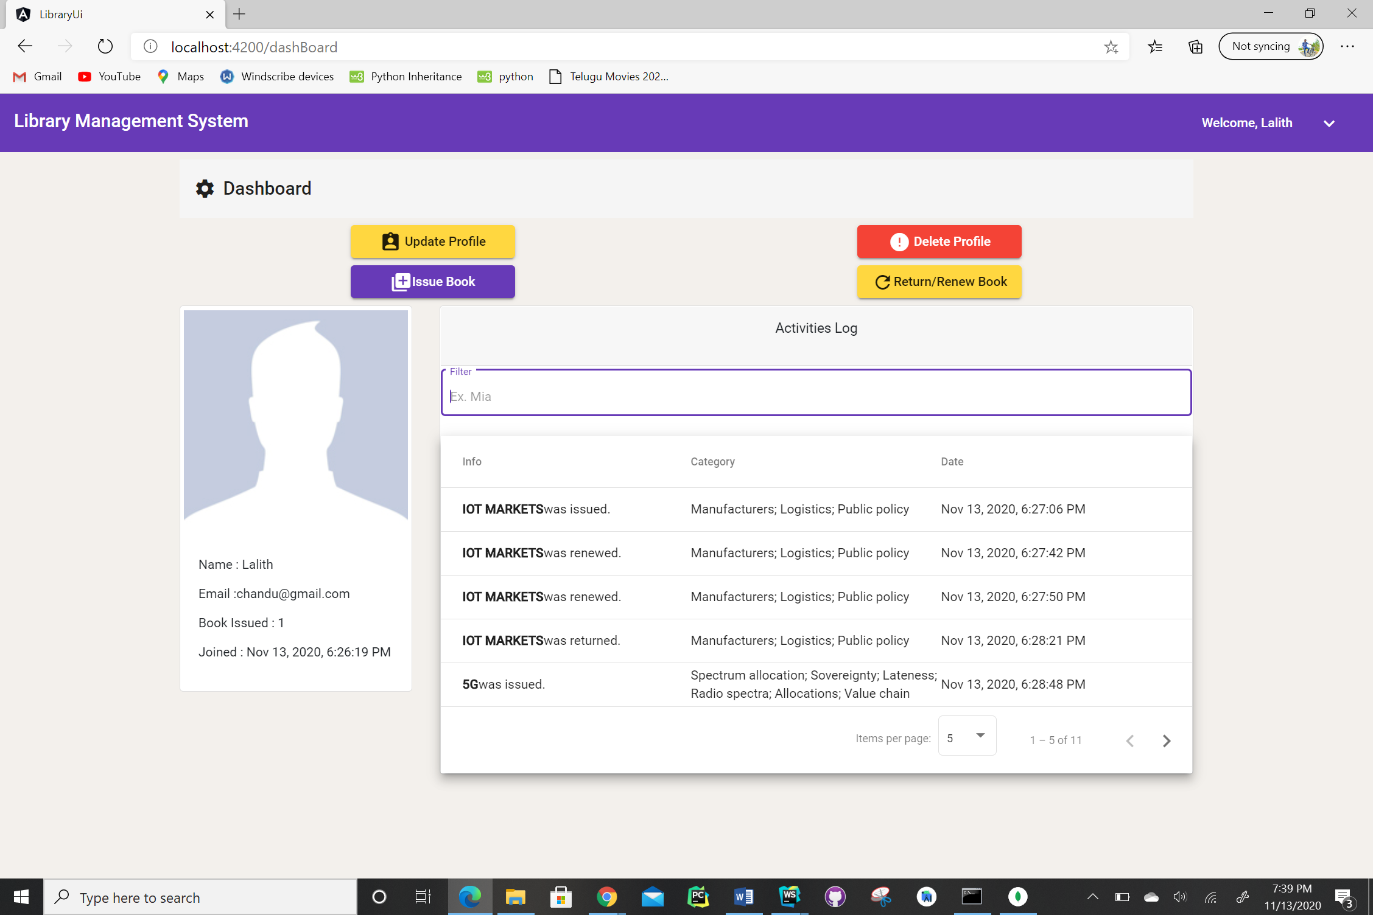
User Screen Dashboard

Slide 22
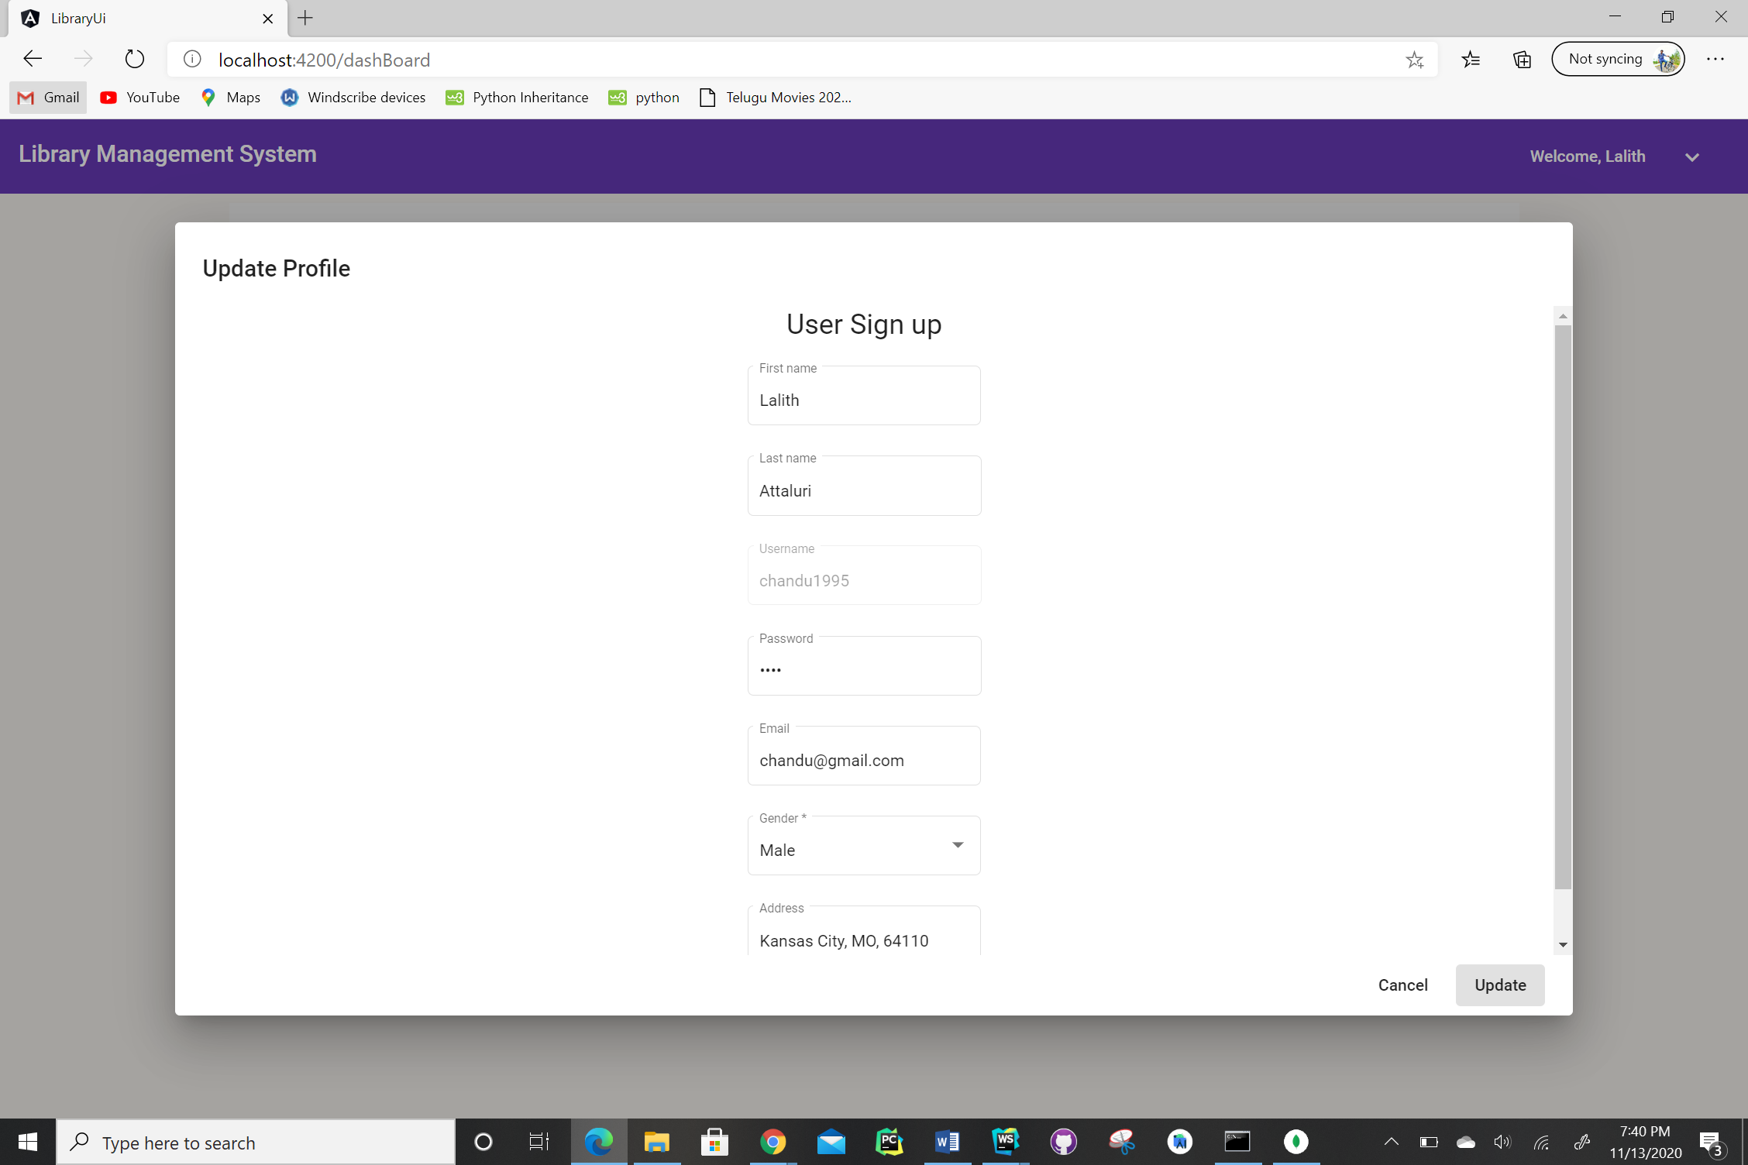
User Profile Update Screen

Slide 23
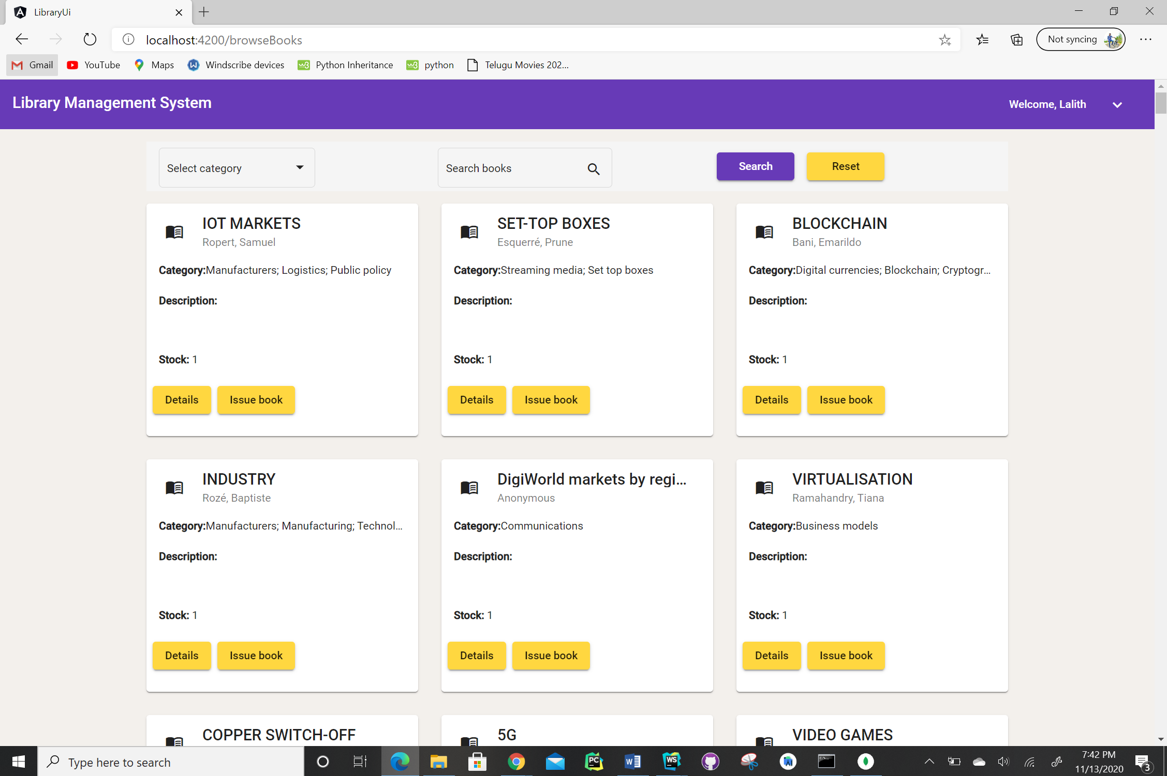
Issuing a Book Screen

Slide 24
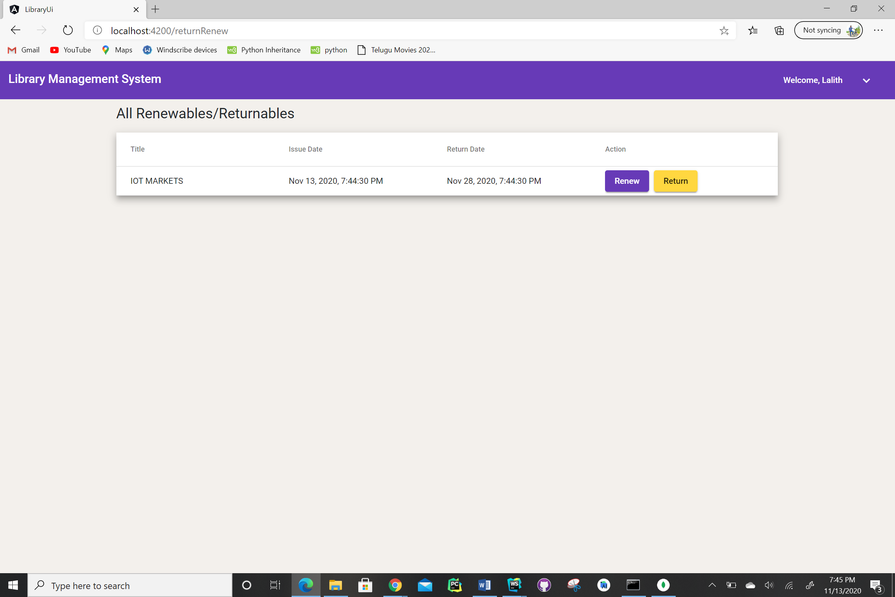
Renewing and Return Screen

Slide 25
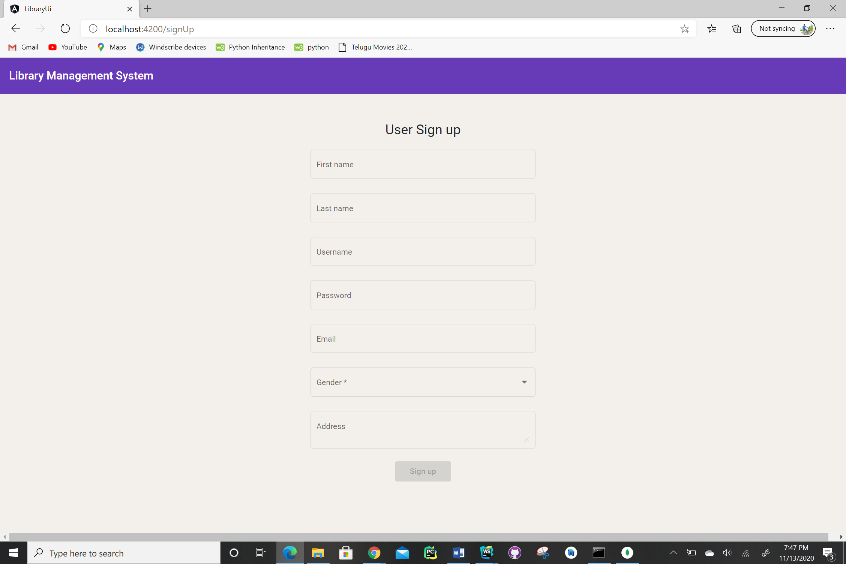
User Signup Screen

Slide 26
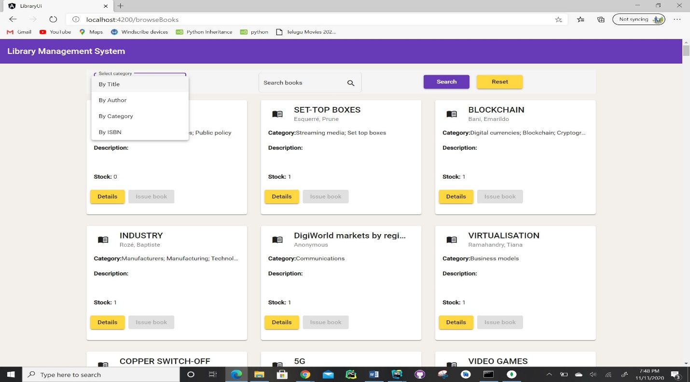
Search Books Screen

Slide 27
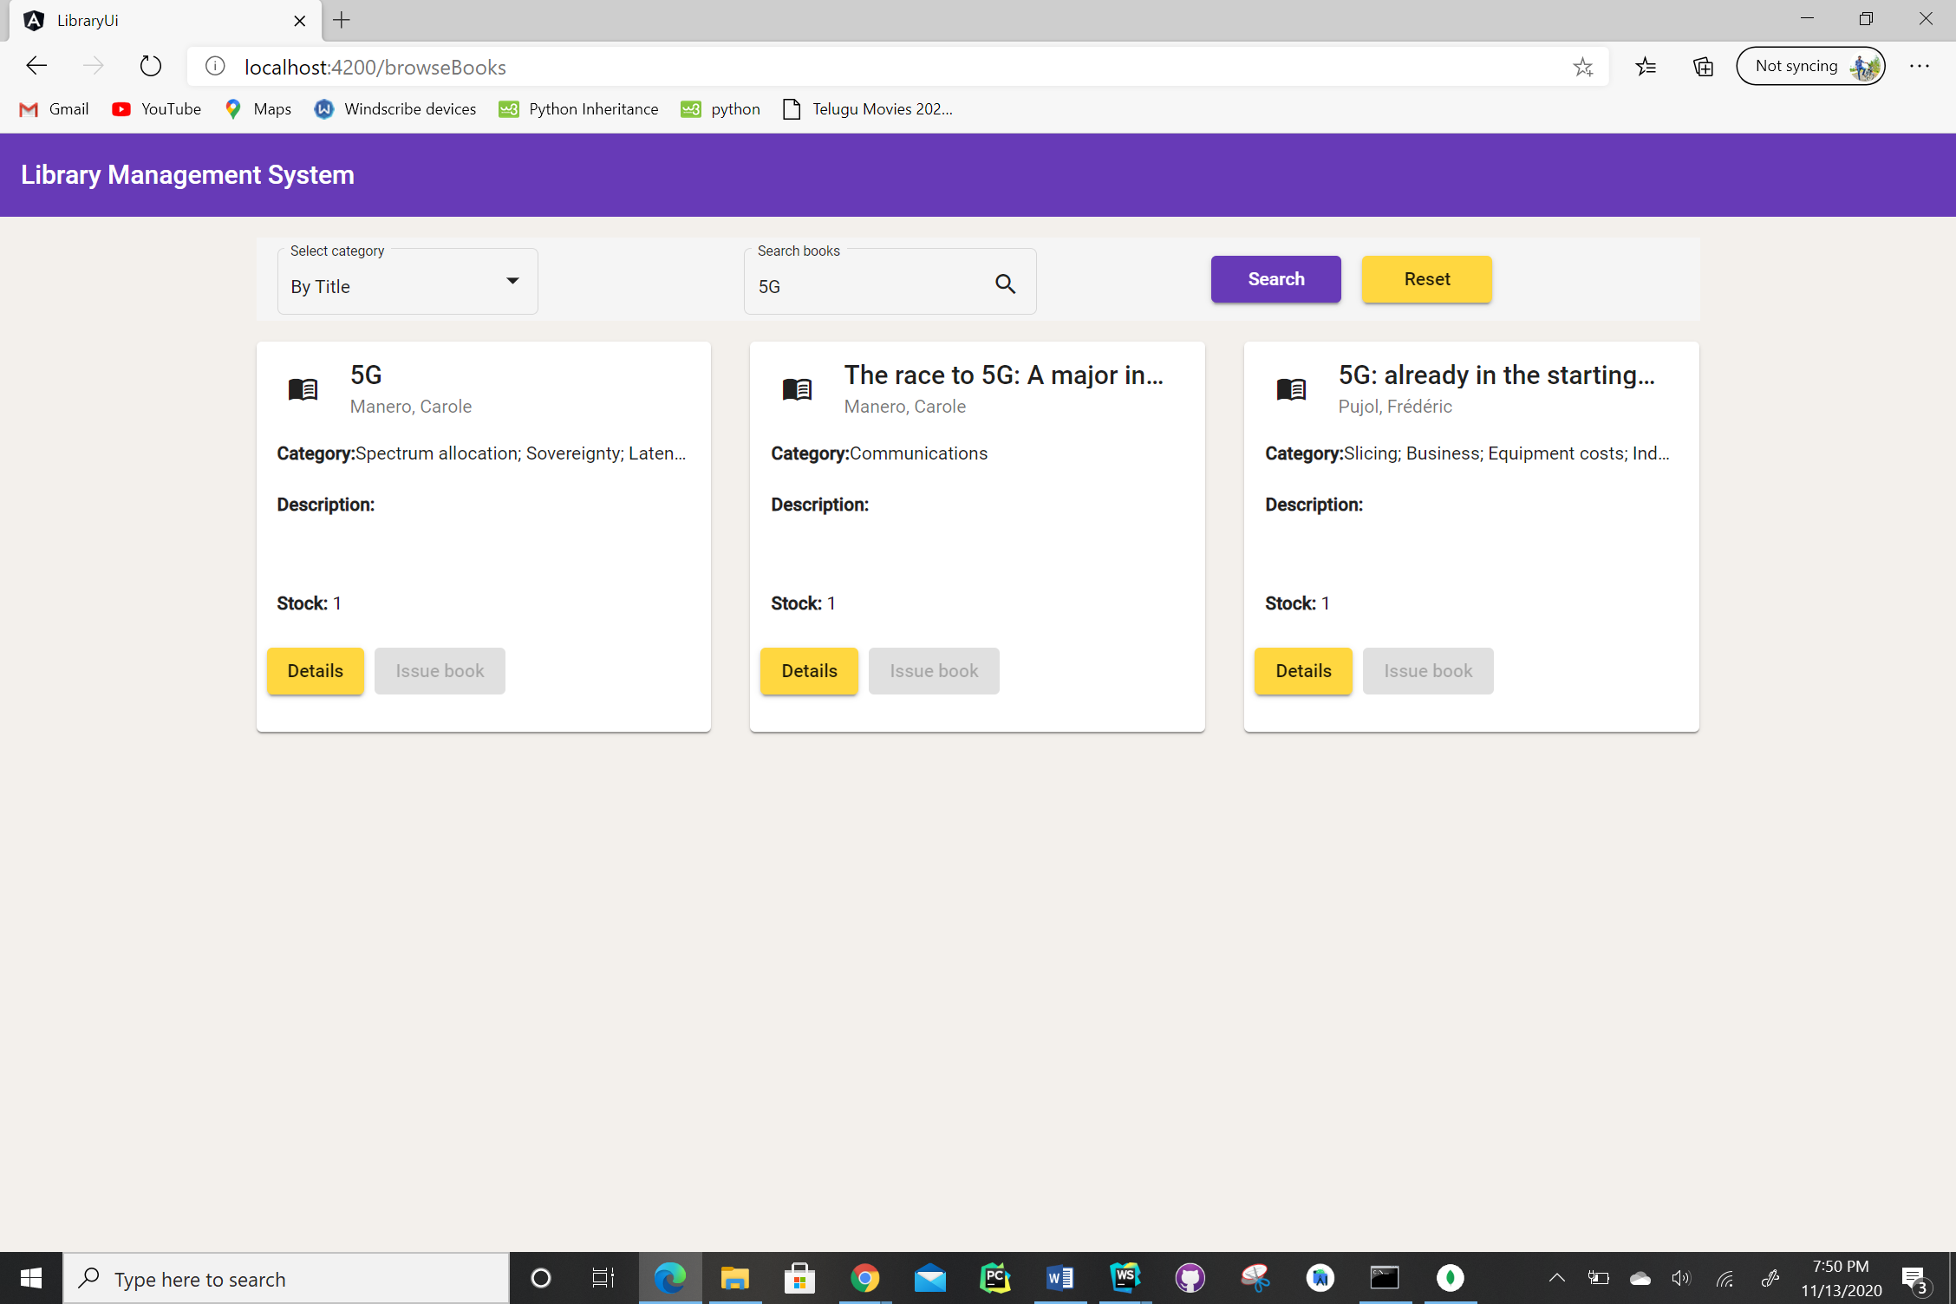
Search by Title Screen

Slide 28
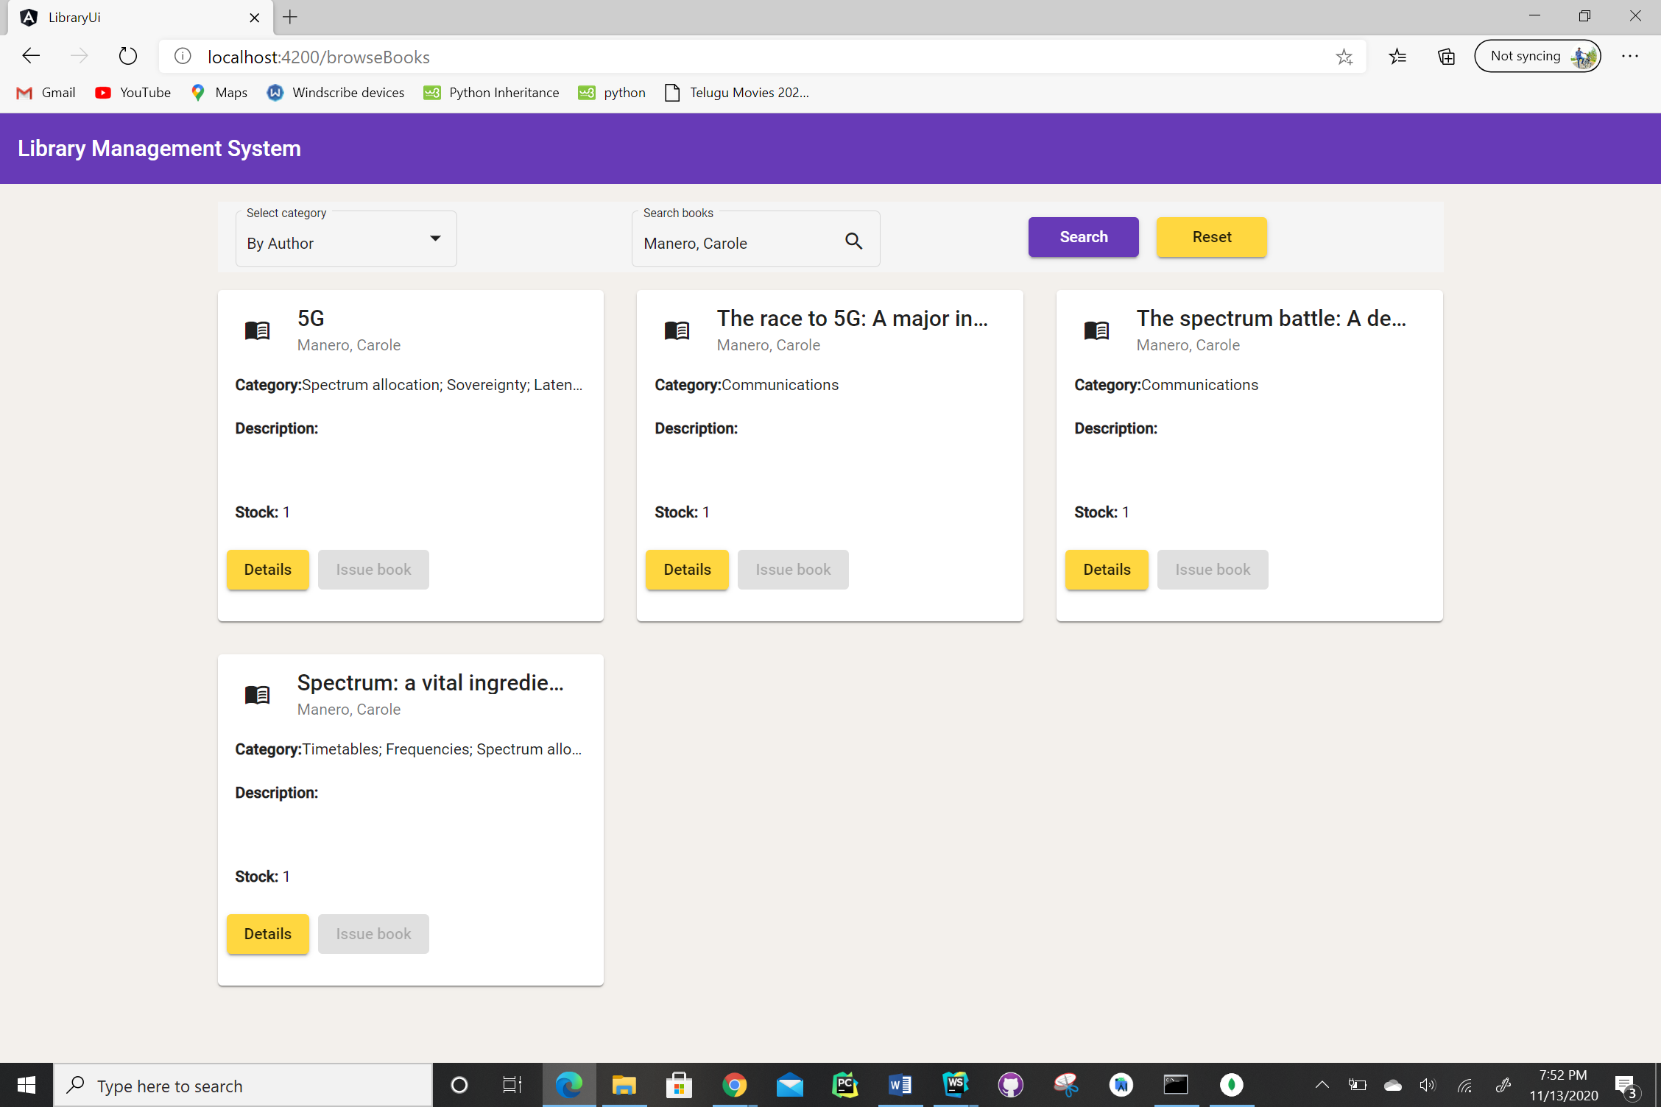
Search by Author Screen

Slide 29
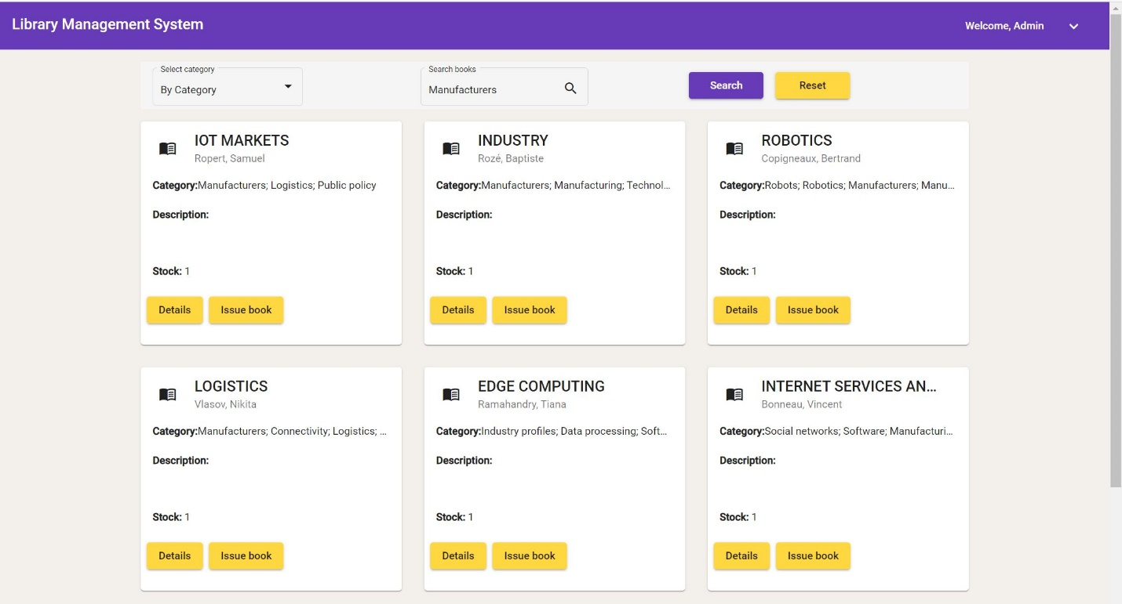
Search by Category Screen

Slide 30
Responsibilities
Admin Privelages and Documentation: Lalith Chandra Attaluri
User Privelages: Udaya Byreddy
Mongo DB Cluster, Login & Signup page: Madhu Varma Rudraraju

Slide 31
References
https://angular-templates.io/tutorials/about/learn-how-to-build-a-mean-stack-application
https://medium.com/better-programming/mean-stack-application-why-should-you-use-it-for-development-c3be2f7aed51

Slide 32

Thank You

